Slide 1


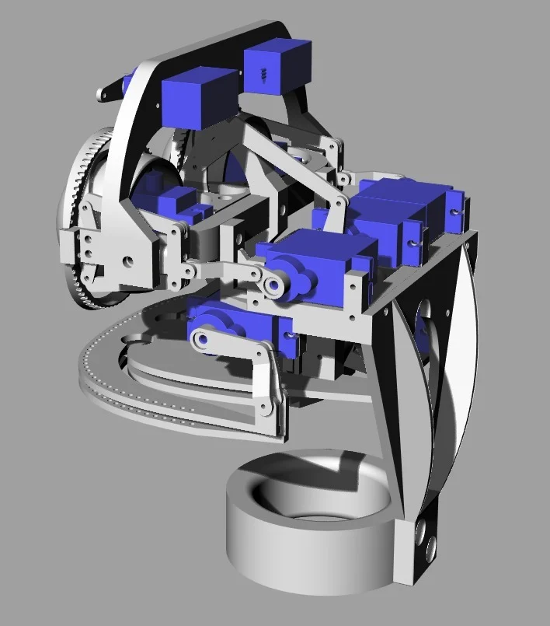
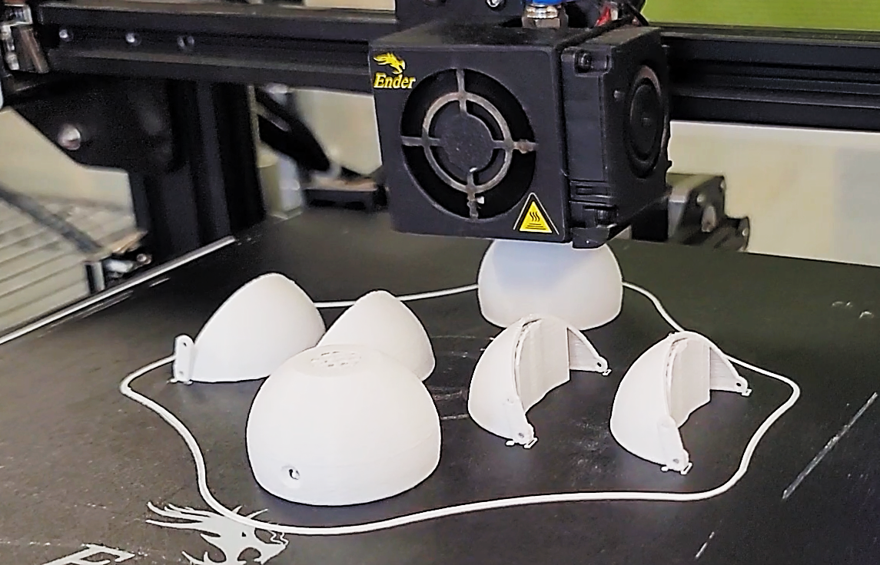
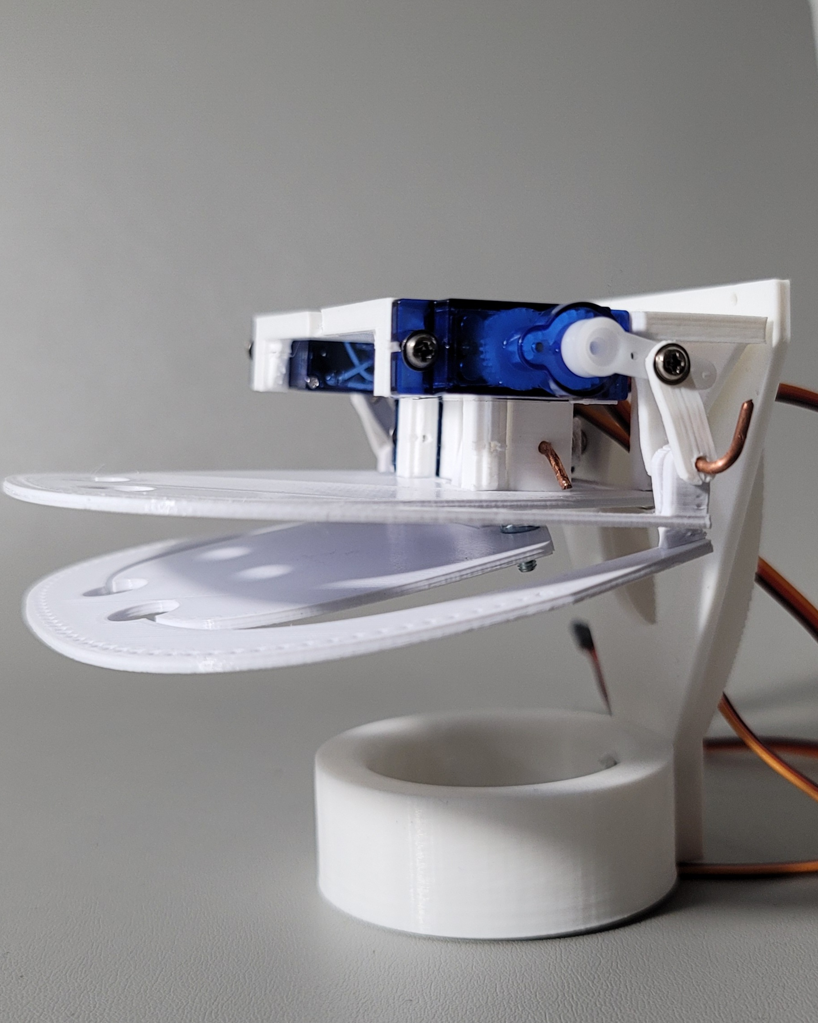
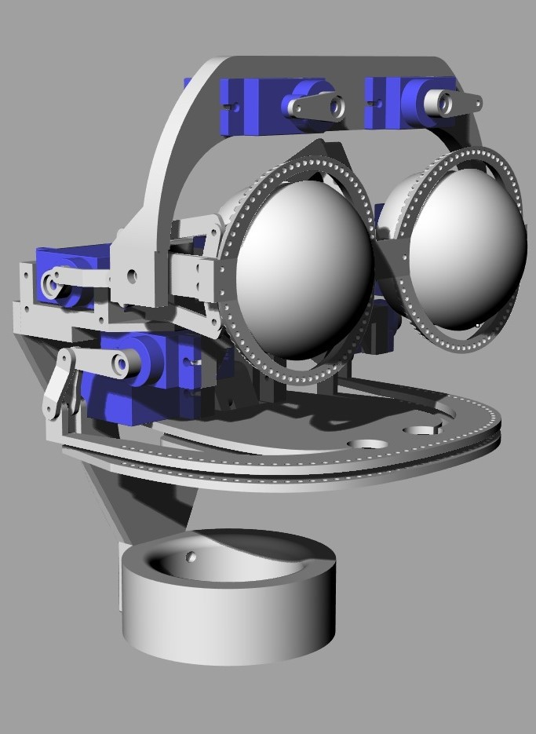
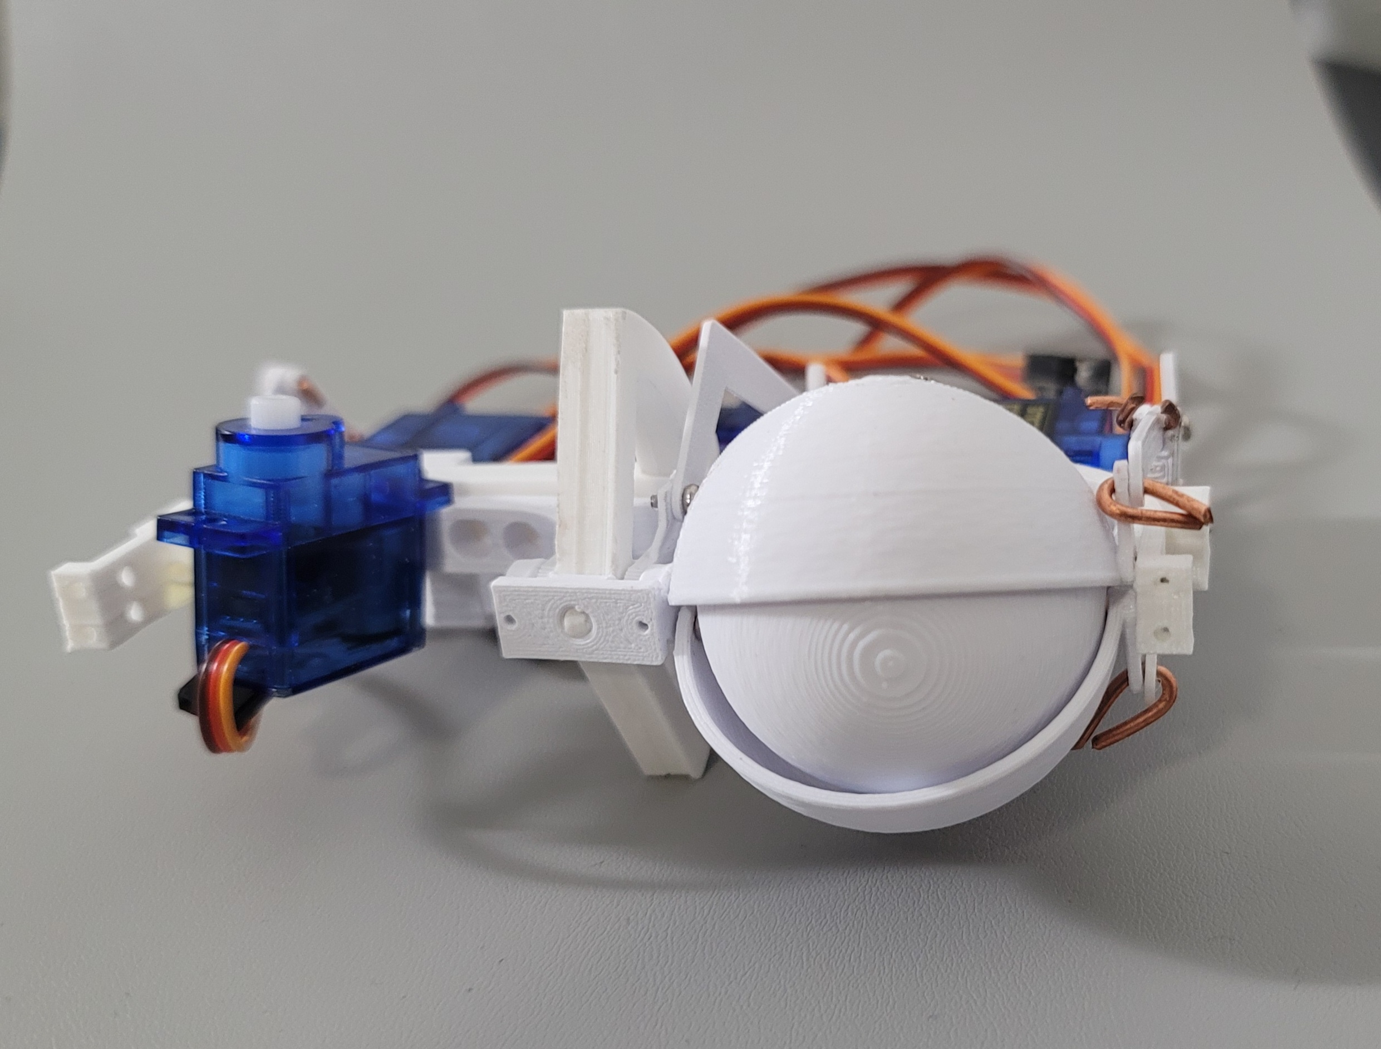
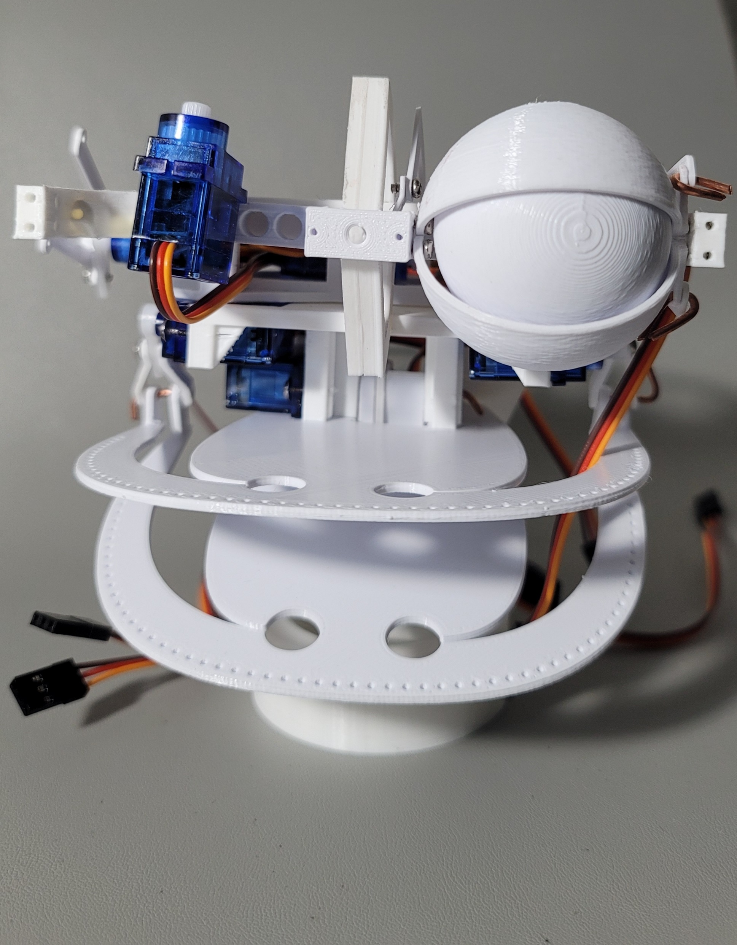
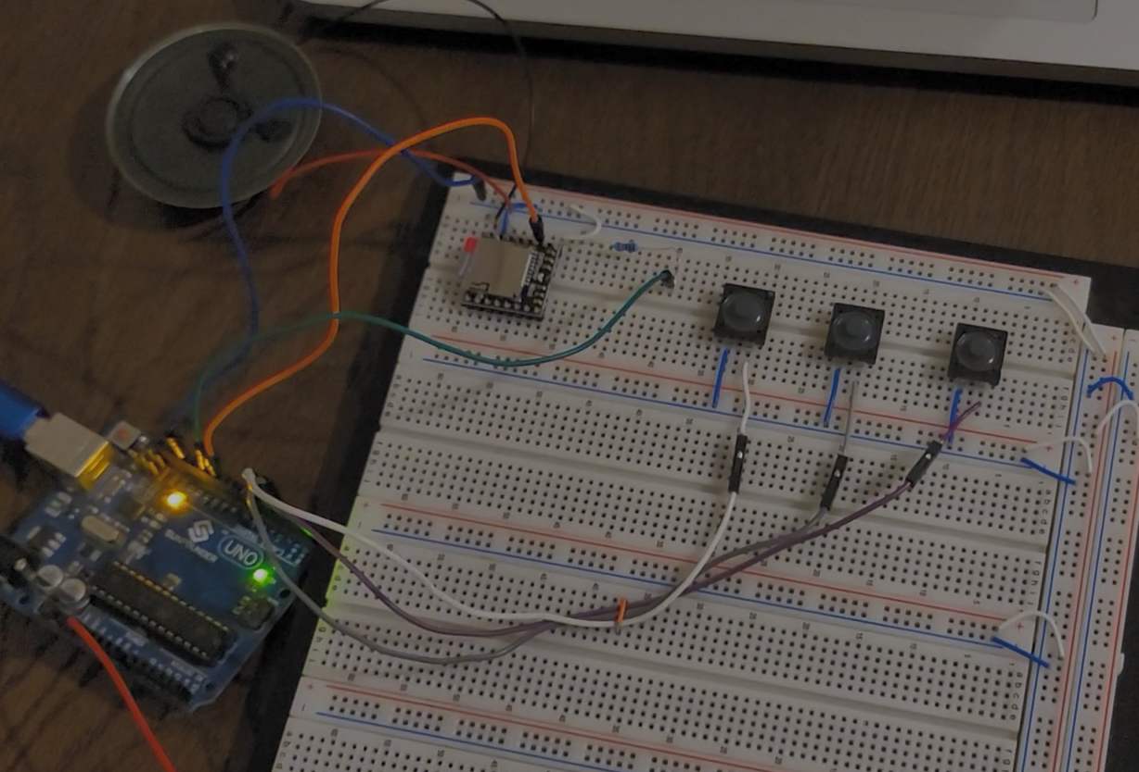
Animatronic Microcontroller Based Robot
Carlos Zarco, Electrical and Computer Engineering Department
Mentor: Dr. Mohamed Aly
RSCA 2024
Abstract
Joint Functions
Figure 2 (left). This image shows an Ender-3 printer that is printing out two circular semi-circles for the eyes and 4 eyelid pieces. They are printed with overhang since they have arches that are above 45° and impossible for the printer to print otherwise
For my KHC Honor’s Engaged Learning Experience, I decided to construct and program an Arduino-controlled animatronic robotic head. This project can be themed to an original character much like the animatronics that one would see at an amusement park. This project aligns with my educational goals as I want to pursue a career in the robotic engineering industry and work at an animatronics company such as Disney’s Imagineering or Garner Holt Productions.
It features 10 moving joints that are all servo-controlled. The animatronic is a robotic head that features eyes, eyelids, eyebrows, and a jaw. The animatronic was 3-D printed almost entirely in PLA plastic, aside from some screws and copper wire used as rods for hinge joints. The servo motors are controlled via an Arduino Uno microcontroller. There is also a way for the animatronic to make sounds as well via a dedicated MP3-playing device that can be integrated with the animatronic system to play music, voice clips, or other sounds.
1 servo for upper and lower jaw movement
This allows the animatronic to move and appear as though it were talking.
2 servos to control frown/smile (one for each side)
The jaw plates are semi-flexible allowing for a servo on each side to slightly bend these plates up or down to simulate smiling and frowning.
2 servos to control eyebrows (one for each side)
These servos have no levers or gears attached and are used to be able to independently control each eyebrow to better express emotions and facial expressions.
2 servos to control eyes moving left and right (one for each eye)
2 servos to control the eyelids (one for each side)
The eyelids for each eye move concurrently however the eyes can blink independently from each other to allow for winking.
1 servo to control eyes looking up and down
Lastly, there is a single servo motor that is used to pivot the eyes up and down.
These 10 servos can be independently controlled which should allow for a large range of expressions and movements to be possible. Including frowns, smiles, blinking, winking, talking, and more.
Figure 3. This image shows the circular base, back neck plate and both jaws for the unit. Copper wire is used at crucial hinges/levers that need to freely rotate to allow for the mouth to function.
Figure 4. This is a 3-D render of how the robot looks when the jaw and eye units are connected to each other (Jethon 2018). The two halves do not have to be connected depending on the application.
Figure 1. 3-D render of the animatronics' side profile (Jethon 2018). This image showcases a few of the servos used for the eyebrows, eyelids, eye rotation, as well as the smile/frown mechanism.
MP3 Player
Additional Hardware
References
An MP3 playing system was integrated for use in conjunction with this animatronic system. I used a DFPlayer Mini module. This module features a micro-SD card reader, a built-in audio amplifier, and interfaces with microcontrollers through UART serial communication. This is how the animatronic is given a voice. Sound effects and voice clips can be played while the jaws are in motion to give the appearance of talking. This module works well with the Arduino Uno that is used to control the system.
The MP3 playing system is volume adjustable and the built-in audio amplifier means that a speaker can be directly connected to the module. The micro-SD card stores the files to be played. The Tx and Rx ports are wired to their respective software serial ports on the microcontroller unit. These pins act as UART serial communication for commands to be sent and received by the DFPlayer mini module. This module can also send messages back to a computer so the messages can read from the serial monitor.
Figure 3. This is the 3-D printed eye plates, mounting bracket, eyeball, and eyelids. Only one side is complete to demonstrate where the servo for left/right eye control is located.
Additional Hardware that is used to hep control the servos is a servo module. I chose to use the PCA9685 16 Channel 12-Bit PWM Servo Motor Driver. This driver allows for up to 16 servos to be independently controlled through PWM. This is fitting for my project since otherwise I would need to use 10 PWM ports on the microcontroller and it emlimantes the possibility for future additions. The PWM for all 10 motors has to be calibrated and each have functions associated with them to more easily move the animatronic quickly in the main loop.
I also used a DC Voltage Regulator unit. This is because the module I am using for the servo motor driver is powered independetly from the Arduino Board. I need to step-down the voltage from a 9V battery that I am using to power it to an acceptable range for the module to function correctly. This is only because I want the animatronic to be battery operated.
[1] Thingiverse.com, “Mouth and eye brow mechanics, adaptable to eye mechanics by Rolf Jethon,” thingiverse.com, Apr. 15, 2018, https://www.thingiverse.com/thing:2863069 (accessed Aug. 23, 2023).
[2] Thingiverse.com, “Eye mechanics with all possible movements by Rolf Jethon,” thingiverse.com, Feb. 4 2018. https://www.thingiverse.com/thing:2781756 (accessed Aug. 23, 2023).
[3] N. Koumaris, “MP3 PLAYER USING ARDUINO AND DFPLAYER MINI,” electronics-lab.com. https://www.electronics-lab.com/project/mp3-player-using-arduino-dfplayer-mini/ (accessed Oct. 2023).
[4] Robojax, “Complete guide to PCA9685 16 channel Servo controller for Arduino with code V1,” YouTube. Dec. 16, 2017. Available: https://www.youtube.com/watch?v=y8X9X10Tn1k
[5] “DFPLayer Mini.” Available:https://picaxe.com/docs/spe033.pdf
‌
‌
‌
‌
Figure 5. A picture of the front of the animatronic. The eye baseplate is attached to the lower neck and circular base below holding up the unit. The eyes can be painted, and a cover can be mounted on to the holes in the top and bottom jaw to hide the electronics.
Figure 4 above. A picture of the Arduino Uno microcontroller connected to the DFPlayer Mini Module. command to the module: previous, pause and next, respectively.

